Slide 1
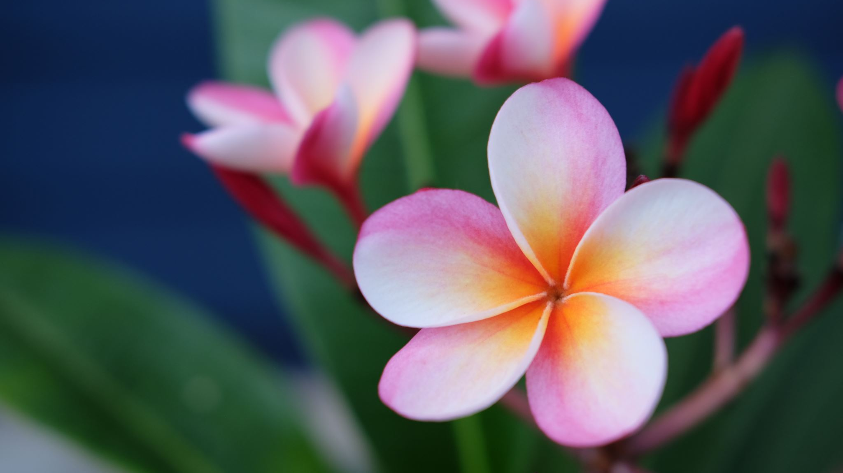
Thai Flowers and Plants
Computer Vision Term Project By
Paveena Chuayaem(6430103)
Kyi Phyu Shin (6530335)
Noel Paing Oak Soe (6530183)

Slide 2
Table of Contents
First Attempt
Second Attempt
Third Attempt
Our Results
What is for Future?

Slide 3
First Attempt (Libaries Used)
Torch
Transfomers (GLPNImageProcessor, GLPNForDepthEstimation)
Open3d
Matplotlib
Pillow
Numpy

Slide 4
First Attempt (Description)
Image Preprocessing: Loads and resizes images for depth estimation.
Depth Prediction: Uses a GLPN model to predict depth maps from input images.
Point Cloud Creation: Combines depth and RGB data to generate a 3D point cloud.
Outlier Removal: Refines the point cloud by filtering out statistical outliers.
Surface Reconstruction: Estimates normals and reconstructs a 3D mesh from the point cloud.
Mesh Visualization: Rotates and displays the final 3D mesh with color.

Slide 5
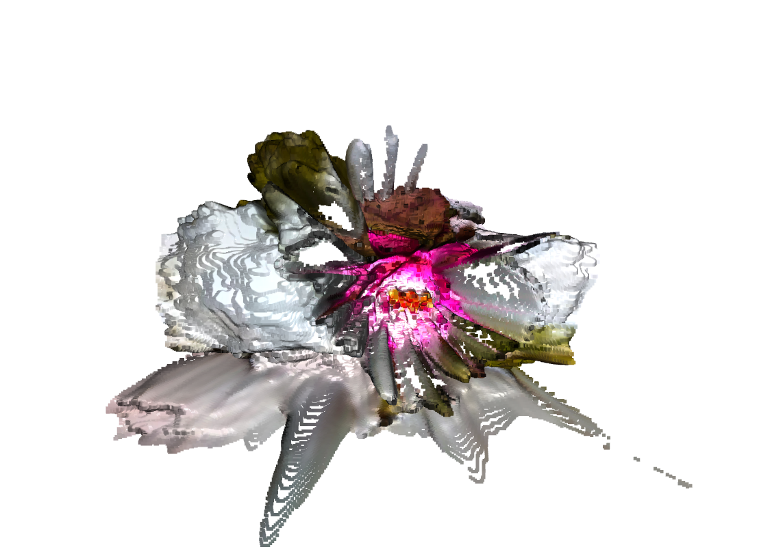
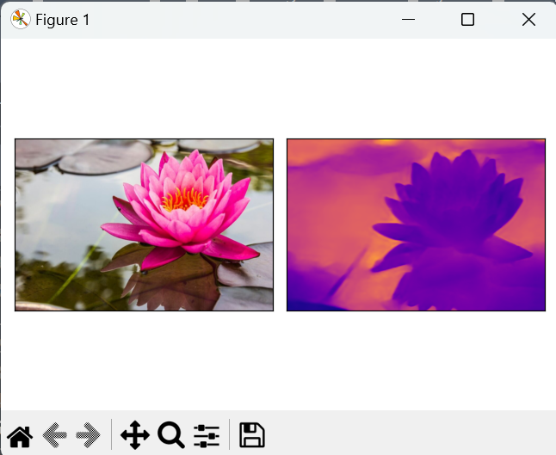
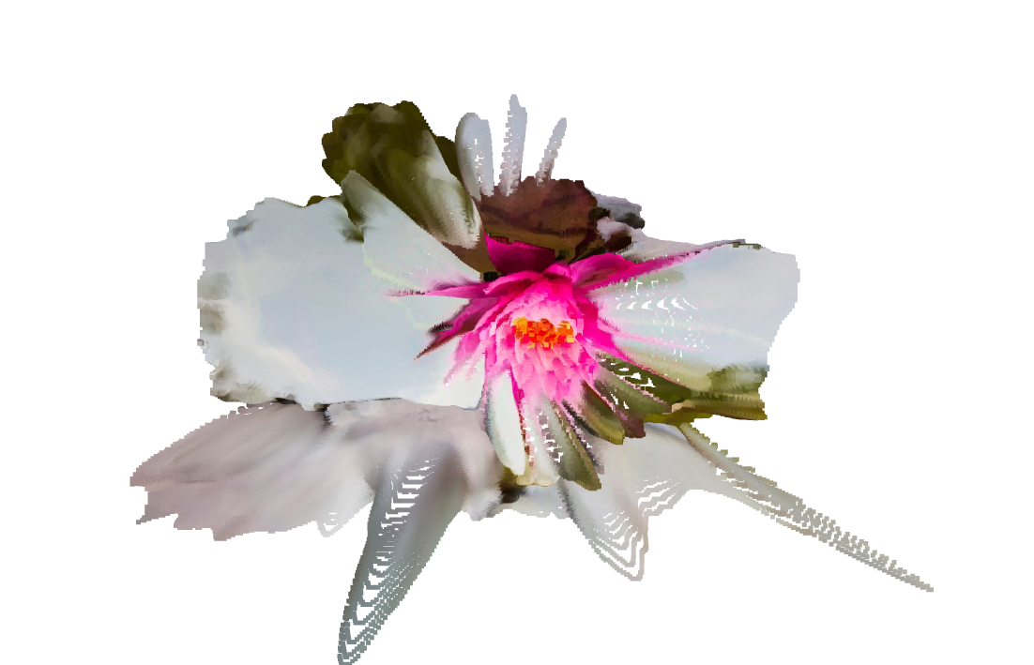
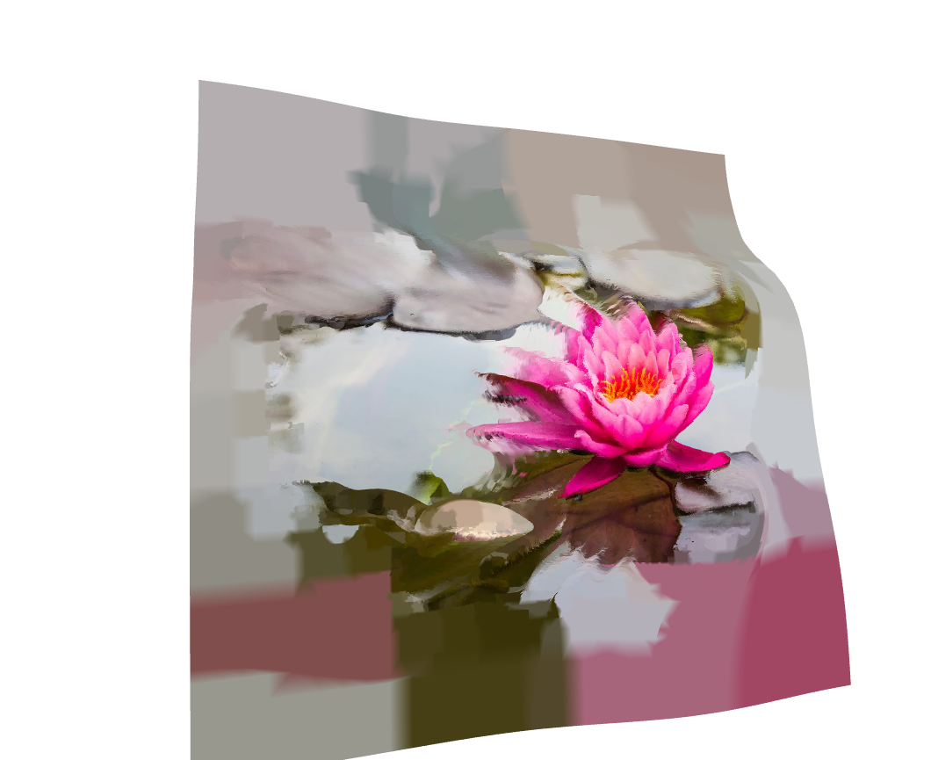
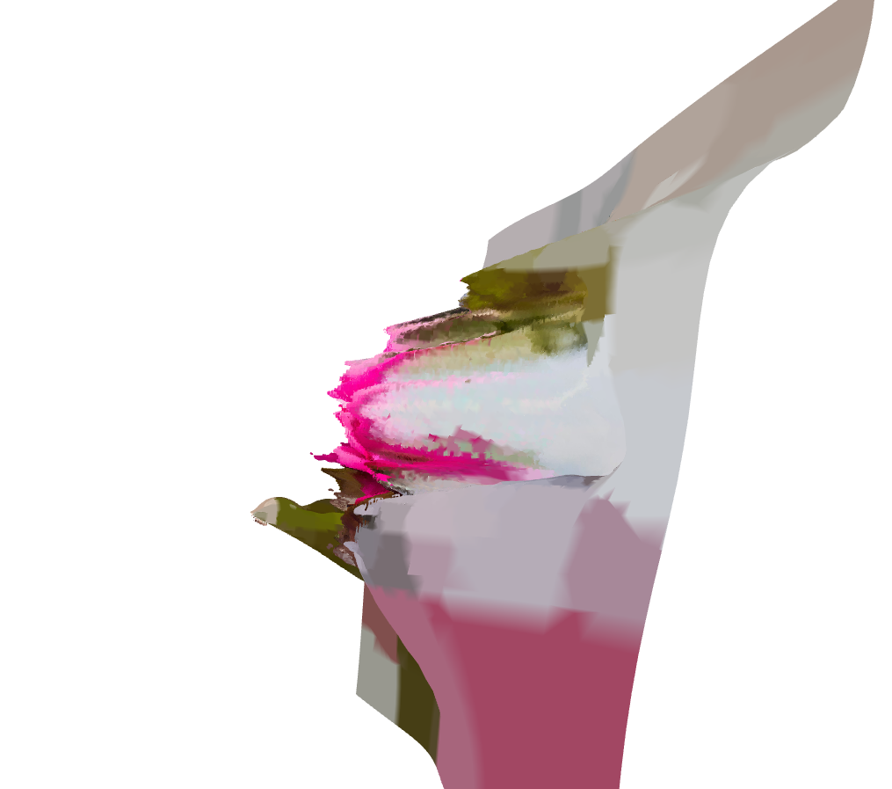
First Attempt (Results)

Slide 6
Second Attempt
To converts multiple 2D images from different angels into 3D mesh by using the following libraries
tomlkit
tqdm
matplotlib
scipy
cv2
numpy
os

Slide 7
Second Attempt (Description)
Loading camera intrinsic parameters
Downscaling images and camera matrices
Using SIFT for feature detection and matching between consecutive images
Computing the essential matrix
Recovering camera pose through rotation and translation matrices
Triangulating 3D points from 2D image correspondences
Calculating reprojection error to assess 3D point accuracy
Supporting bundle adjustment for refining 3D points and camera parameters
Saving the final 3D point cloud as a .ply file
Detecting and refining common points across multiple views for accurate 3D structure estimation

Slide 8
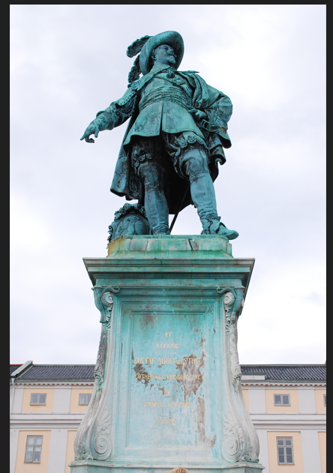
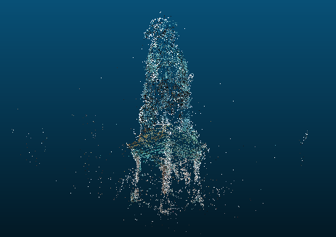
Second Attempt (Result)
Input Images Sample taken from different angles
Output Image

Slide 9
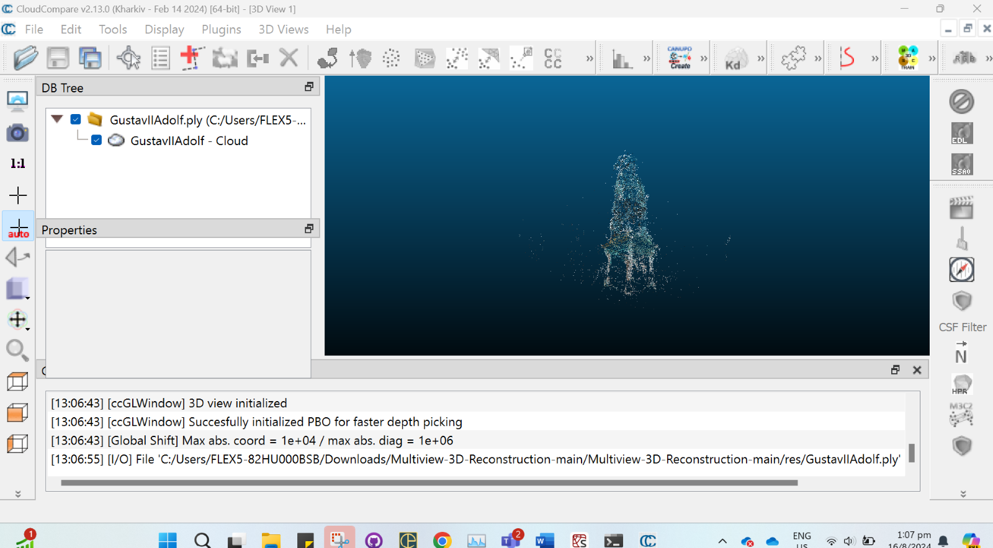
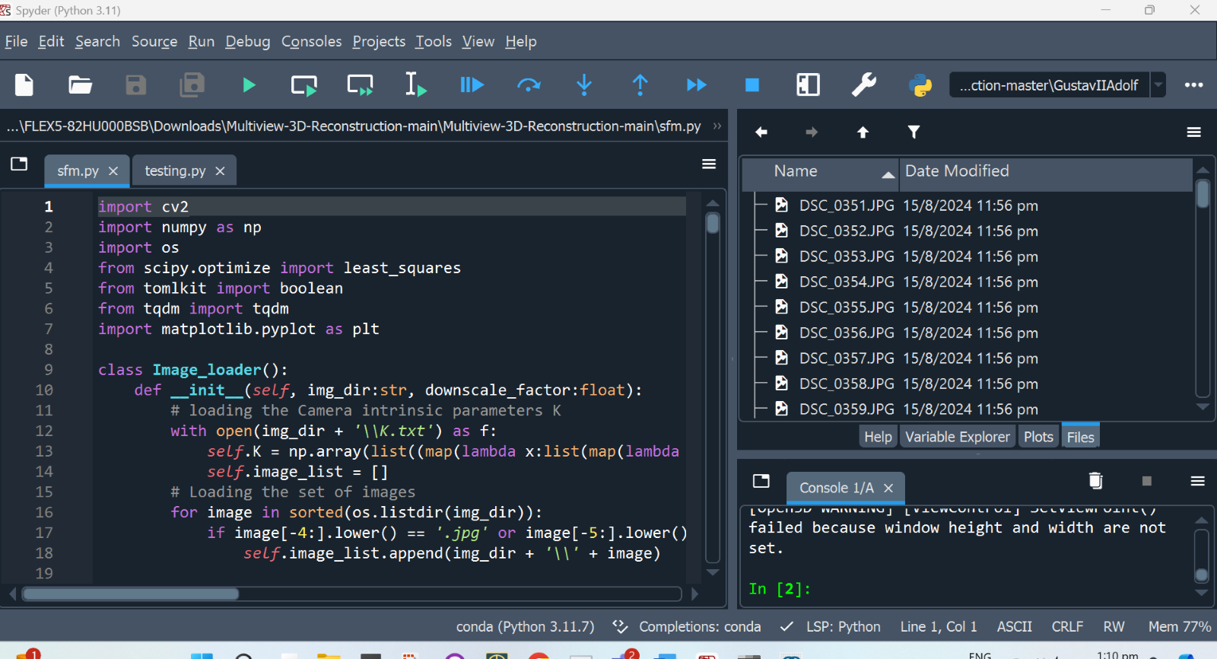
Second Attempt

Slide 10
Third Attempt ( Libaries Used)
Torch
Transfomers (GLPNImageProcessor, GLPNForDepthEstimation)
Open3d
Matplotlib
Pillow
Numpy

Slide 11
Third Attempt (Description)
Image Processing: Resizes and extracts features from a sequence of images using the GLPN model.
Depth Map Generation: Combines depth information from all images to create a unified depth map.
Point Cloud Creation: Converts the depth map into an RGBD image and generates a point cloud in Open3D.
Post-Processing: Refines the point cloud by removing outliers and estimating surface normals.
Poisson Surface Reconstruction: Creates a 3D mesh from the point cloud and rotates it for visualization.
Mesh Export: Colors the 3D mesh based on the RGB image and exports it as an OBJ file.

Slide 12
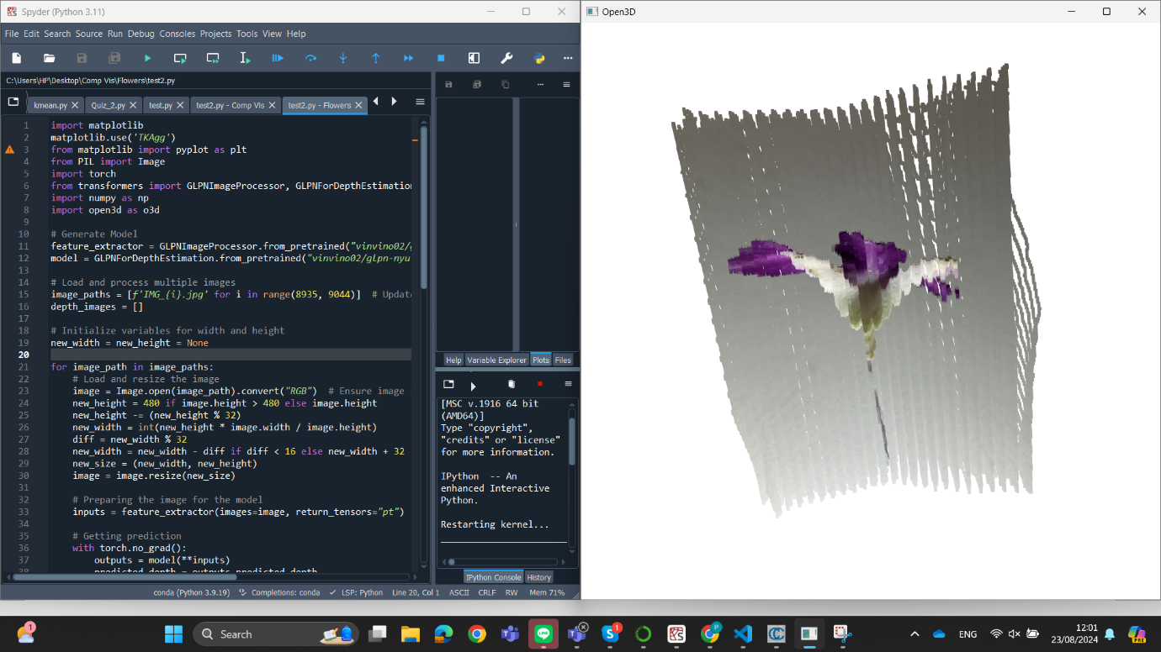
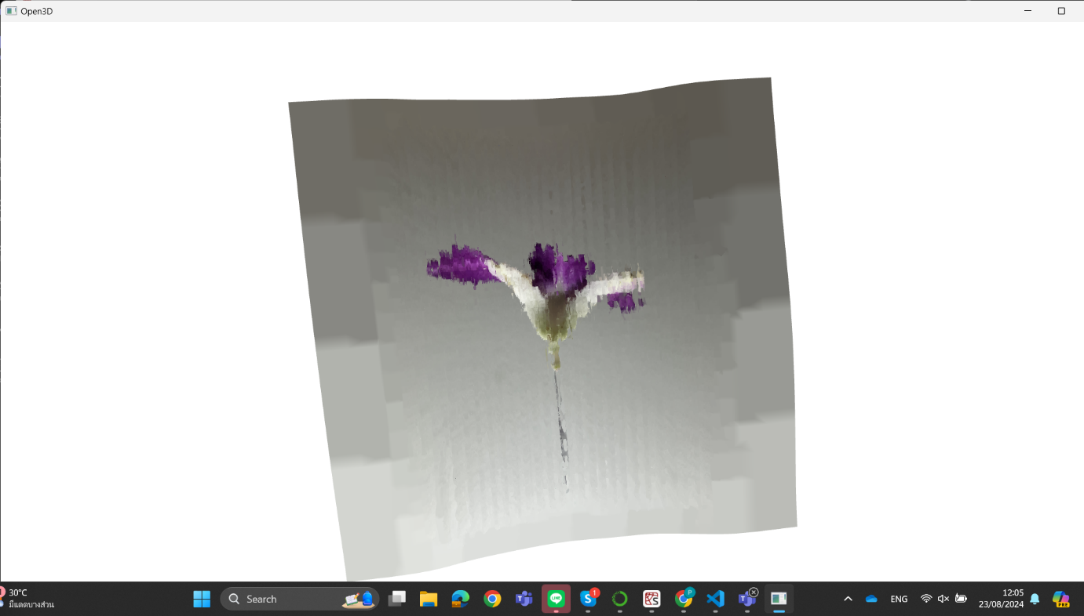
Third Attempt (Results)

Slide 13
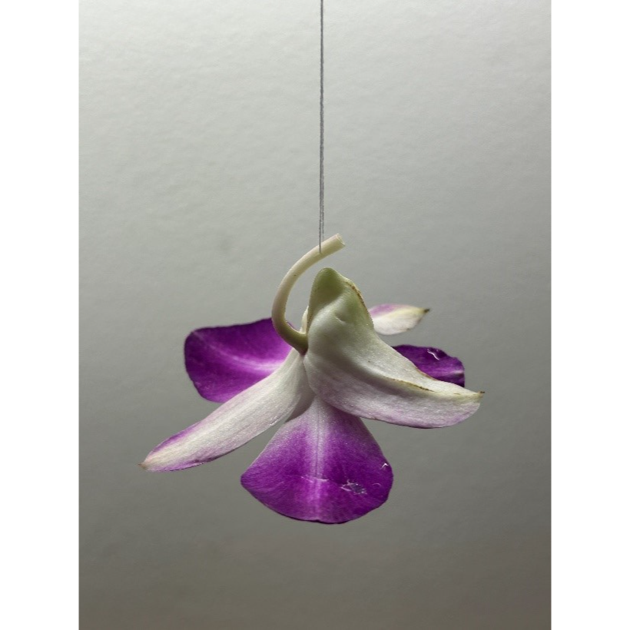
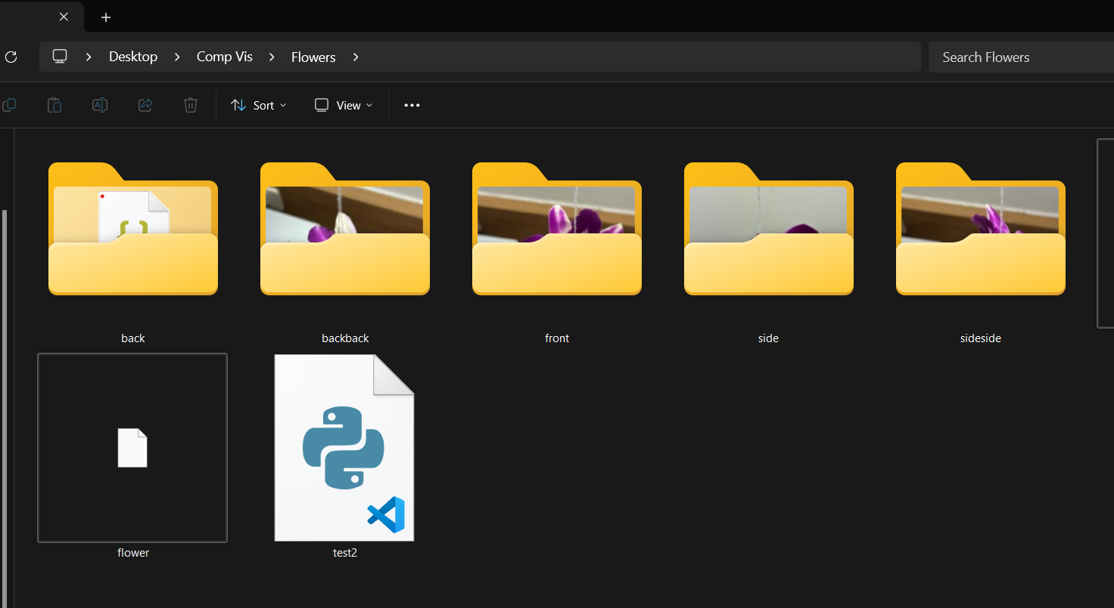
Third Attempt with many picture

Slide 14
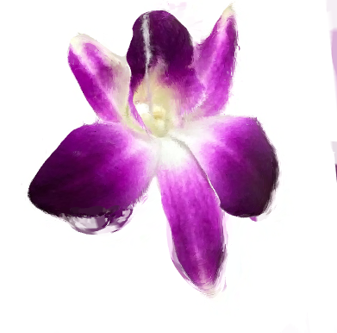
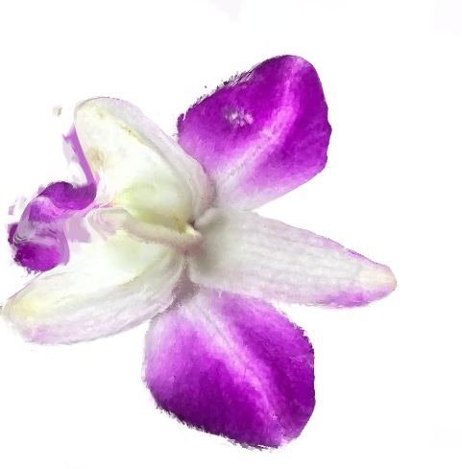
Third Attempt (Results)

Slide 15
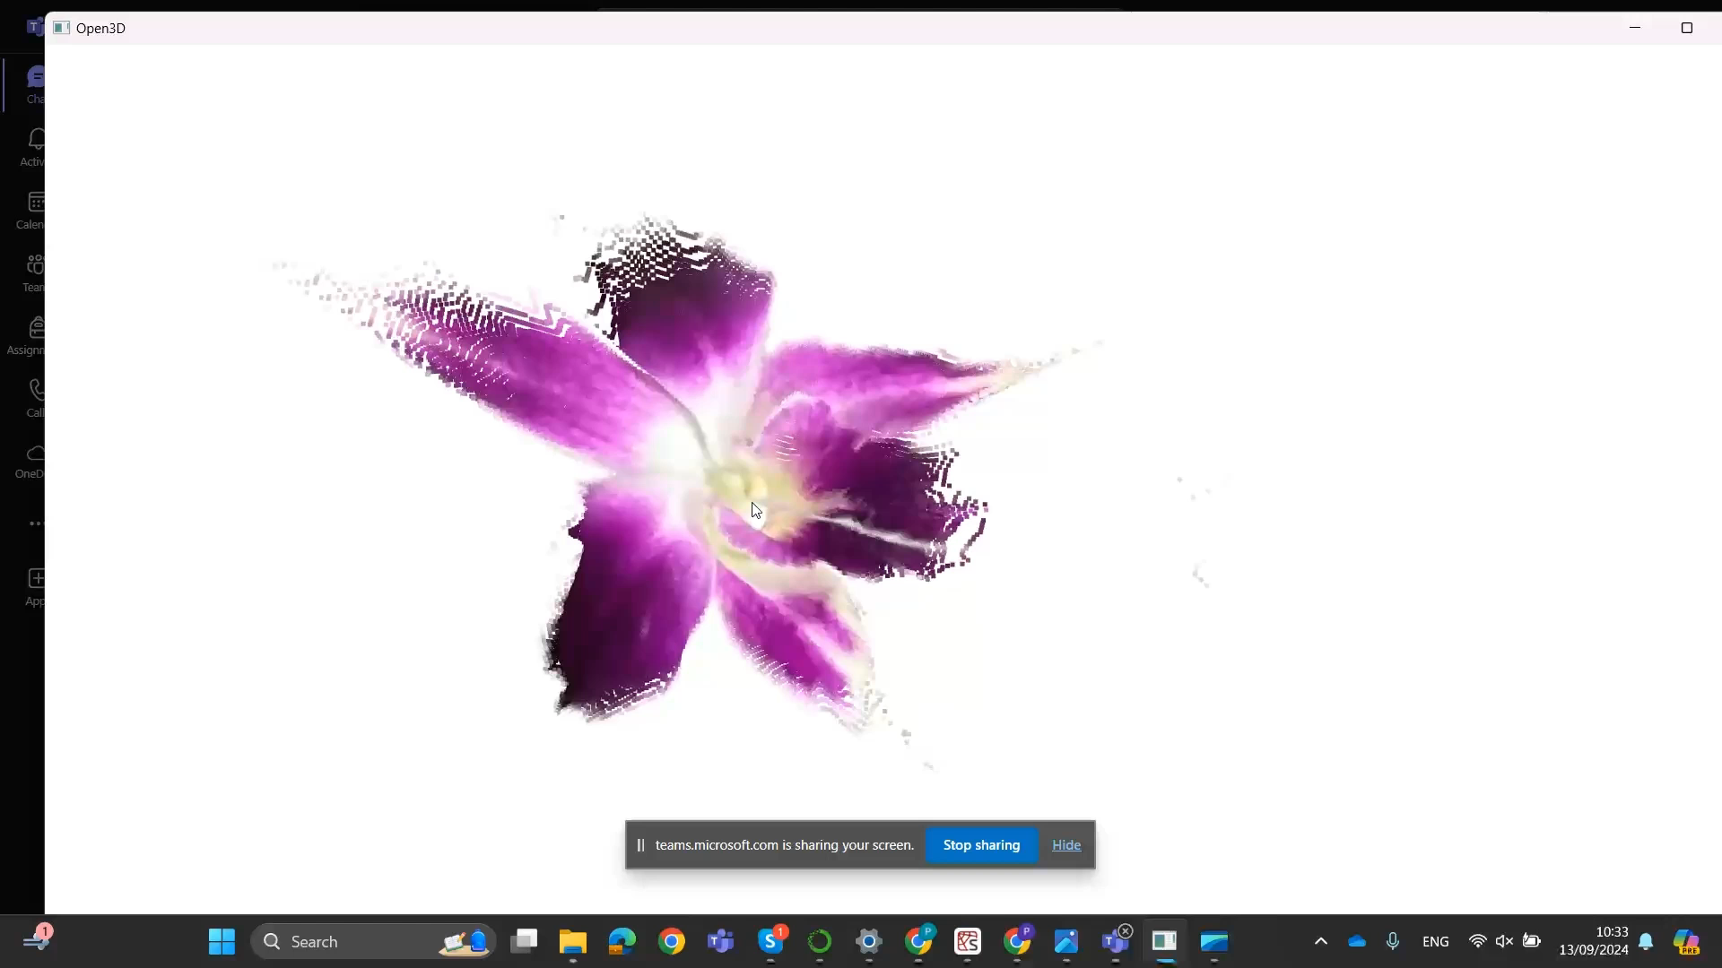
THIRD ATTEMPT(AFTER REMOVAL OF BACKGROUND) RESULT

Slide 16
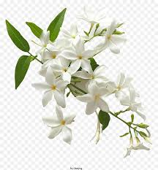
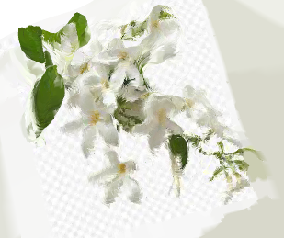
Our Results So Far
Jasmine

Slide 17
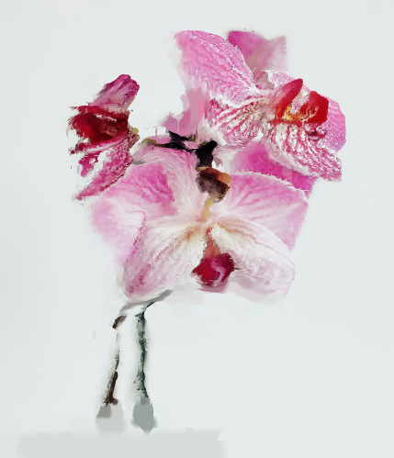

Our Results So Far
Orchid

Slide 18
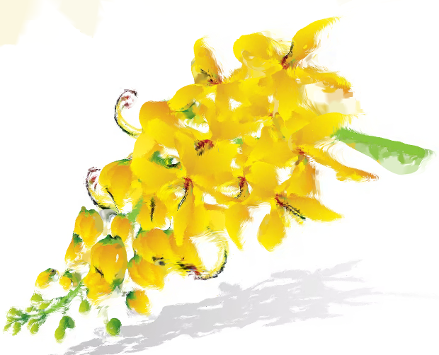

Our Results So Far
Golden Shower Tree

Slide 19


Our Results So Far
Tulip

Slide 20
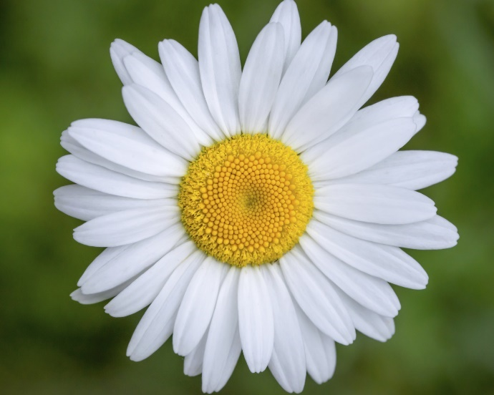
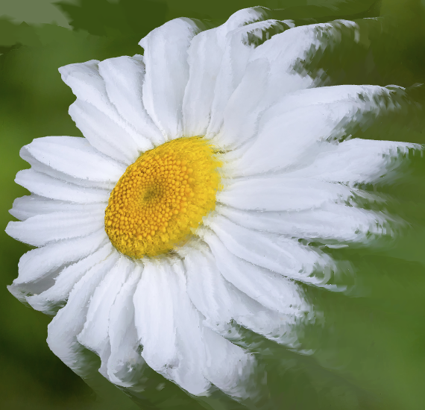
Our Results So Far
Daisy

Slide 21
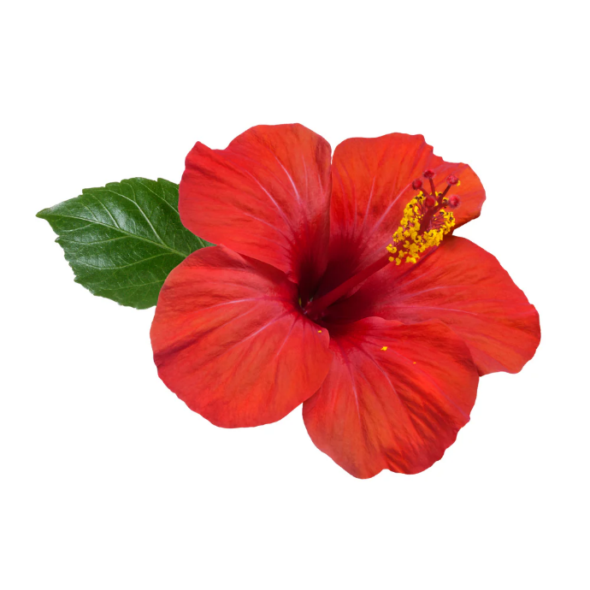
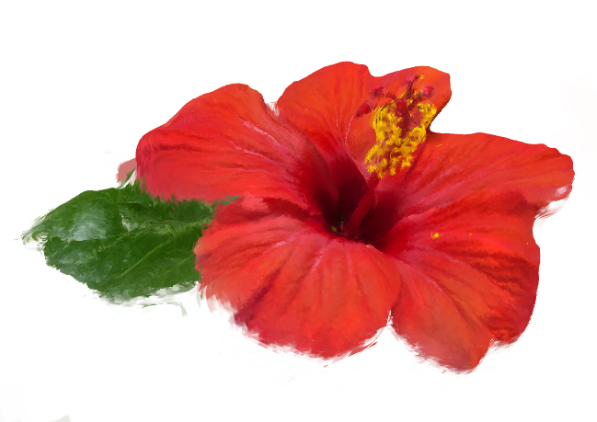
Our Results So Far
Hibiscus

Slide 22
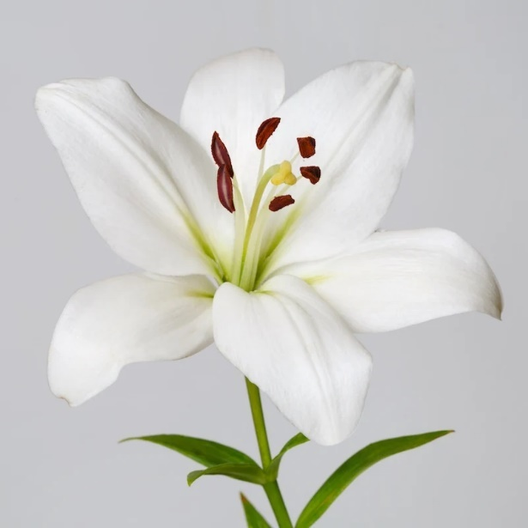
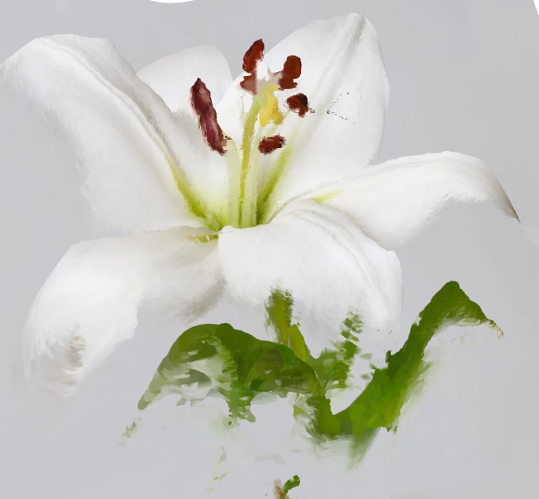
Our Results So Far
Lily

Slide 23
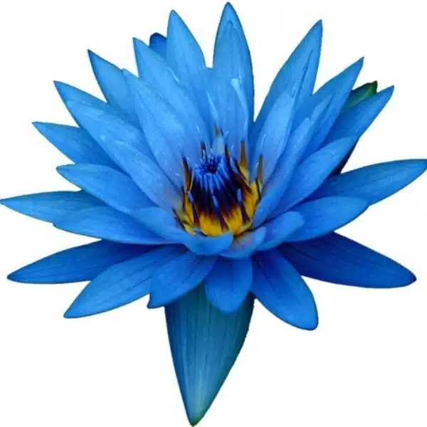
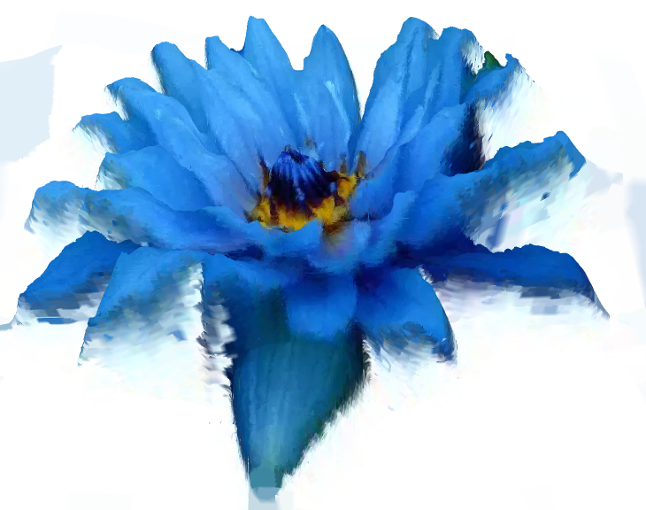
Our Results So Far
Blue Lotus

Slide 24
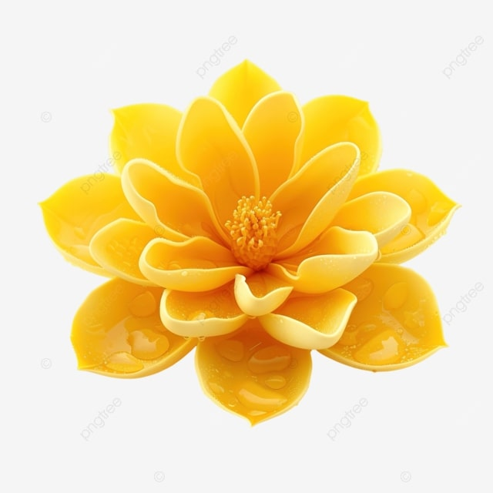
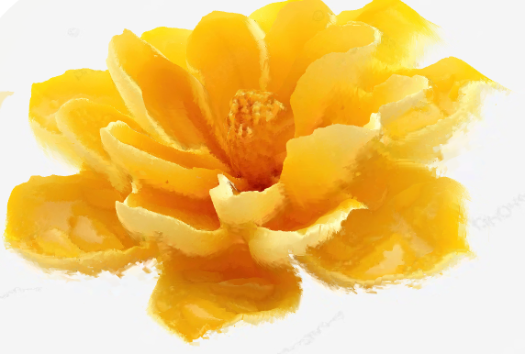
Our Results So Far
Ratchaphruek Flower

Slide 25
What is for Future?
Modify second attempt to automatically take camera’s intrinsic parameters from images
Modify first attempt to take multiple inputs (images) and produce a better mesh

Slide 26
References
https://arxiv.org/abs/2111.13285
https://inria.hal.science/hal-03686041/document
https://medium.com/hackernoon/key-point-detection-in-flower-images-using-deep-learning-66a06aadc765
https://www.youtube.com/watch?v=5ypQIUbpA7c&t=197s&pp=ygUSM2QgcG9zZSBlc3RpbWF0aW9u

Slide 27
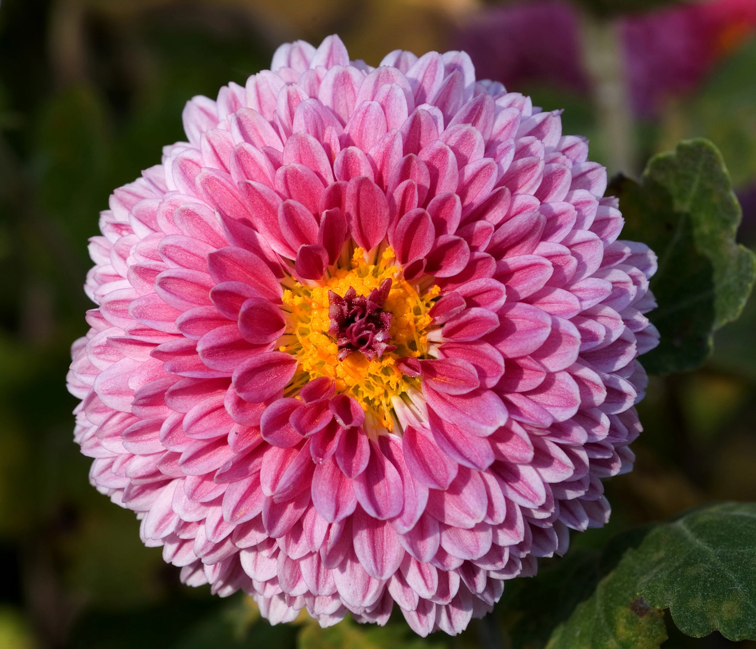
Thank You

